Slide 1




Machine Learning
Comparative Performance Analysis of algorithms in ML body of work
Presented By:
Group 5 (Bayo, Ann, Opeyemi, Blessing)

Slide 2
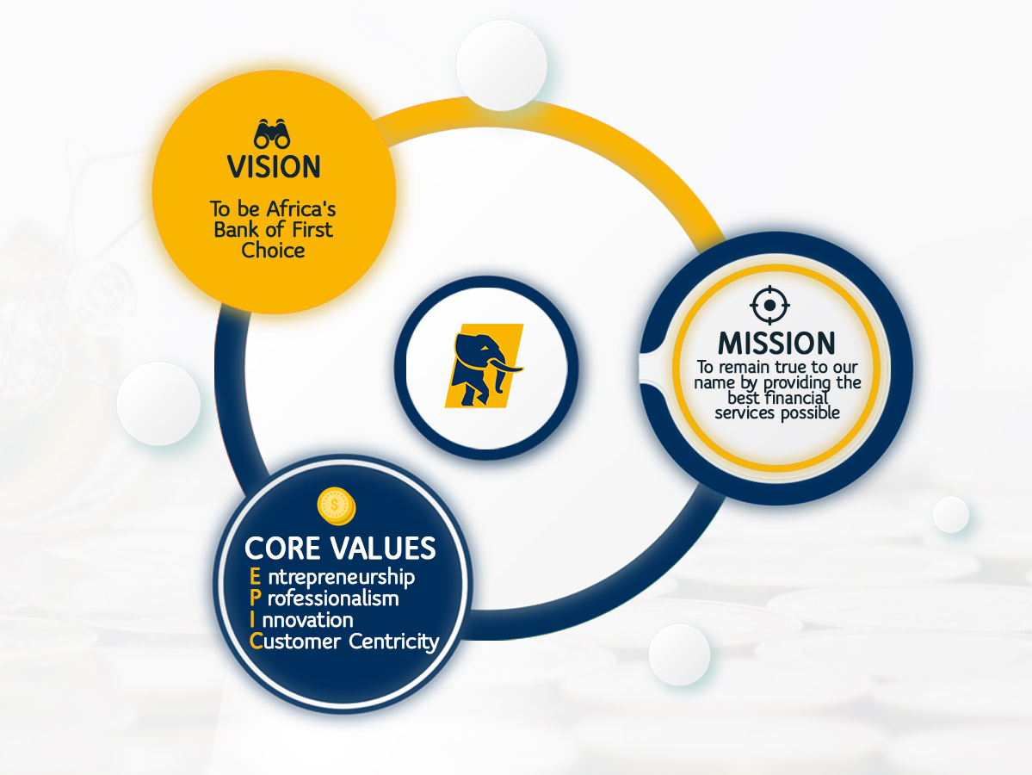

Slide 3


Contents
Introduction
Background of AI
The AI Revolution
Overview of Machine Learning
Types of ML
Techniques in ML
Real Case Scenarios & Performance Analyses
Classification
Regression
Clustering
Reinforcement Learning

Slide 4
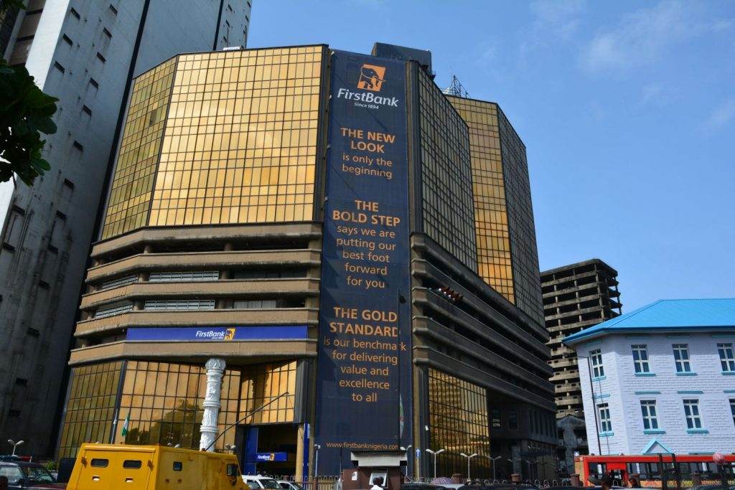

Introduction

Slide 5


Background of Artificial Intelligence
Machines were initially created to assist humans with specific tasks due to their speed and precision, but they are naturally unintelligent.
For machines to optimally assist humans, they need to be capable of thinking, understanding, solving problems, and making decisions.
Alan Turing first questioned whether machines could think in 1955, marking the beginning of artificial intelligence (AI) history.
Artificial Intelligence (AI) is the branch of computer science that deals with creating computer systems capable of performing tasks that typically require human intelligence. ​
AI systems are designed to mimic human cognitive functions and can learn and adapt to new information from their environment

Slide 6


The AI Revolution
AI has been around for decades but is gaining significant traction recently due to the sheer volume of data now available.
Data is essential for training AI models; more data leads to more accurate and effective models, much like practice improves a musician's skills.
The availability of large datasets has led to groundbreaking advancements, especially in finance, where machine learning models trained on extensive market data predict stock market trends with remarkable accuracy.
While AI offers immense opportunities, it also presents challenges. Understanding these algorithms, identifying risks, and evaluating performance is crucial for successful adoption. Hence, this analysis focuses on Machine Learning algorithms, their use cases, weaknesses, and performance evaluation.

Slide 7


Overview of Machine Learning
Machine learning (ML) is a subset of AI that focuses on creating models using algorithms that let computers learn from data. The algorithm is the mathematical life force behind the model. The model is the output of a machine learning algorithm after it has been trained on data.

Slide 8
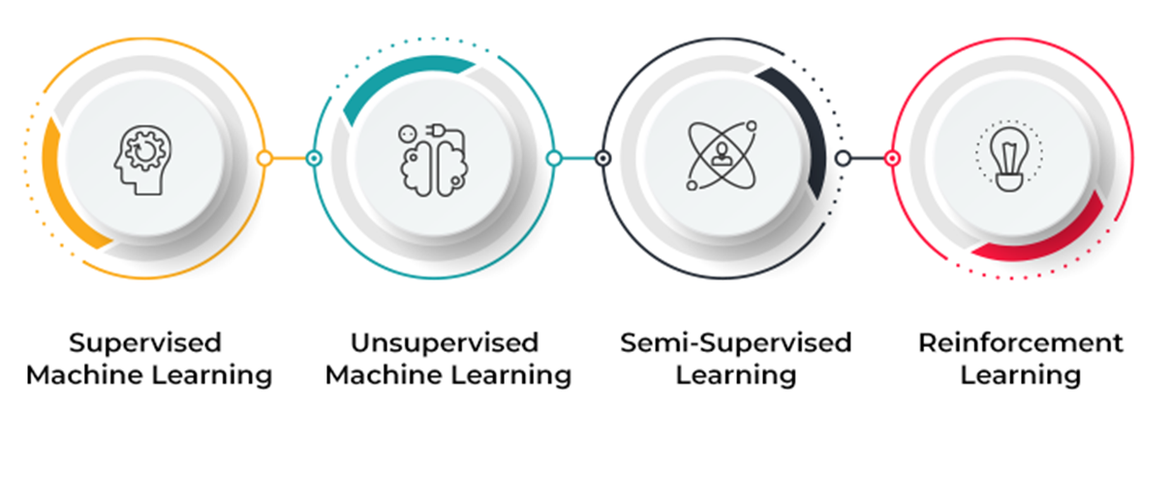
Types of Machine Learning
Types of Machine Learning Algorithms
Supervised Learning: the algorithm uses existing information or data points that come with clear labels or categories
Unsupervised Learning: the data points exist without any attached labels or categories. Unlike supervised learning, which deals with data that is already labeled, unsupervised learning focuses on organizing data and uncovering hidden patterns
Reinforcement Learning: the algorithm determines the best course of action based on data and feedback

Slide 9
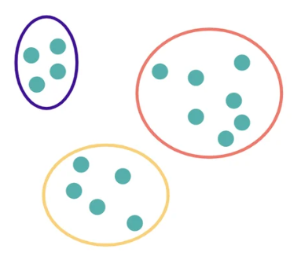
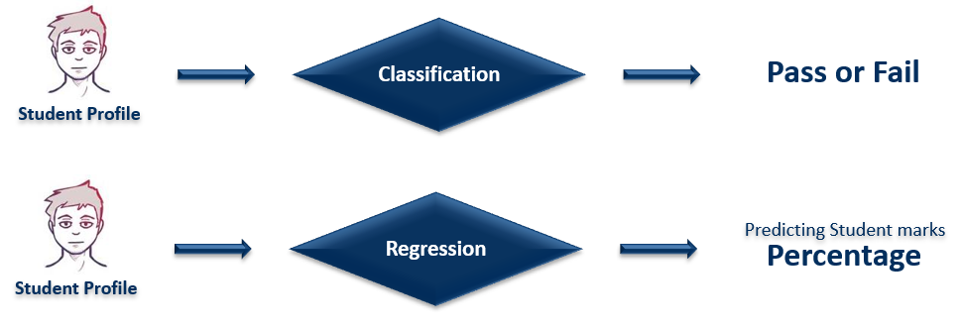
Techniques in ML
Classification is a supervised machine learning method where the model tries to predict discrete target variables using independent features.
Regression is a supervised machine learning method where the model tries to predict a continuous outcome based on one or more predictor variables.
Clustering is an unsupervised machine learning method where the dataset is split into groups (or clusters) based on similar attributes or features
Classification vs Regression
Clustering

Slide 10
Classification
Real Case Scenarios

Slide 11
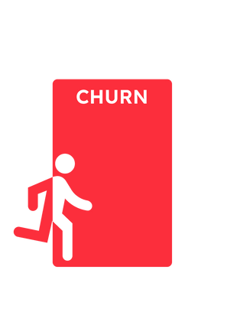

Bank Customer Churn Prediction

Slide 12

Introduction
In the competitive banking industry, every customer counts, and losing a valuable client can significantly impact our bottom line.
According to a study published in Harvard Business Review - Oct 2014, acquiring a new customer can be anywhere from five to 25 times more expensive than retaining an existing one.
But what if we could predict which customers are likely to leave before they make that decision? Then take proactive steps to keep them engaged and satisfied.
By leveraging the power of machine learning and exploring several classification algorithms, we aim to identify patterns and signals that indicate a customer is at risk of churning.

Slide 13
About the Dataset
Data Source: Kaggle
Number of Samples | Number of Features | Labels
10,000 | 11 | 2 (Churned, Stayed)
Data Features: CreditScore, Geography, Gender, Age, Tenure, Balance, NumOfProducts, HasCreditCard, IsActiveMember, EstimatedSalary, Churned or stayed
Approach taken to predict customer churn
Data Collection and Loading: Gathered and loaded the dataset.
Data Exploration and Cleaning: Explored the dataset and check for missing values.
Data Preprocessing: Encoded categorical variables, scaled features, and split the data.
Model Training: Trained the model using algorithms such as Random Forest, Decision Tree, Logistic Regression, SVC, KNN
Model Evaluation: Evaluated the model using accuracy, precision, recall and f1-score to determine the most optimal model for prediction

Slide 14
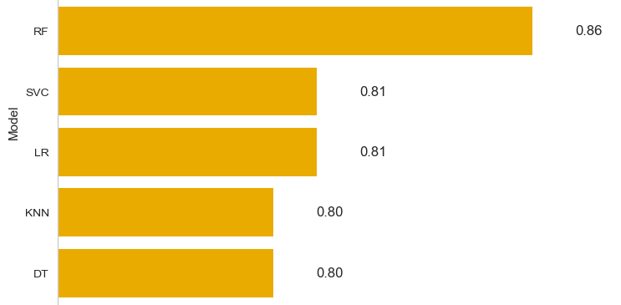
Model Accuracy Result
The goal of using accuracy as a metric is to gauge how well the model is performing overall. It tells us what proportion of the total predictions were correct. A high accuracy score, indicates the model correctly predicts most instances.

Slide 15
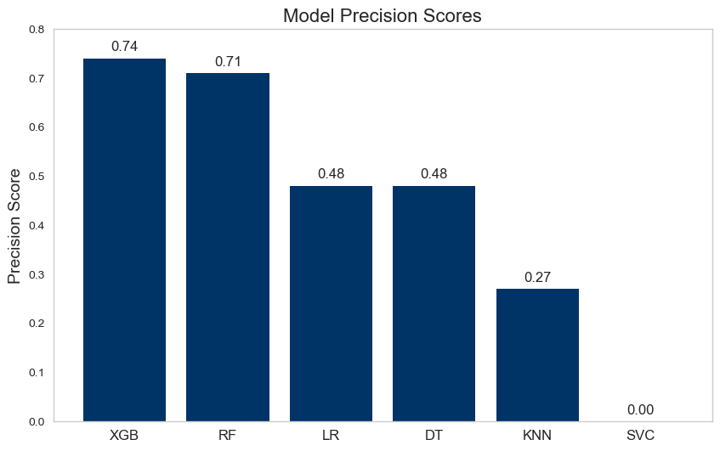
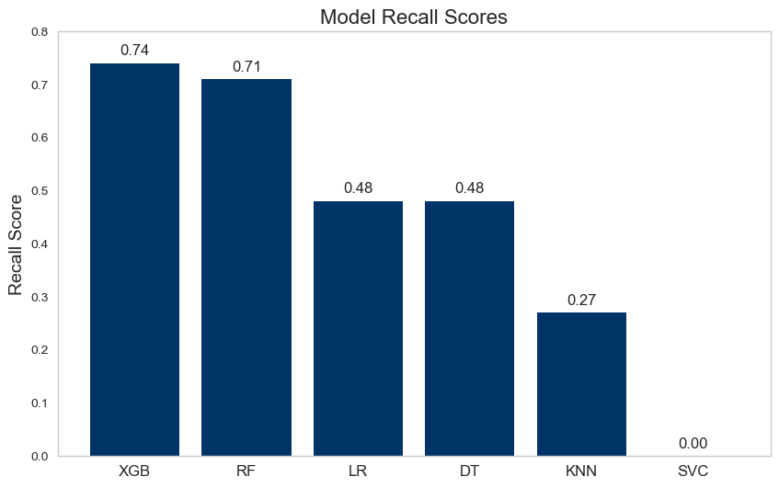
Model Precision, Recall Result
The precision score aim to answer the question “Out of the customers predicted to churn by the model, how many actually did?”
The recall score aim to answer the question, “Out of the customers who actually churned, how many did our model correctly identify?”

Slide 16
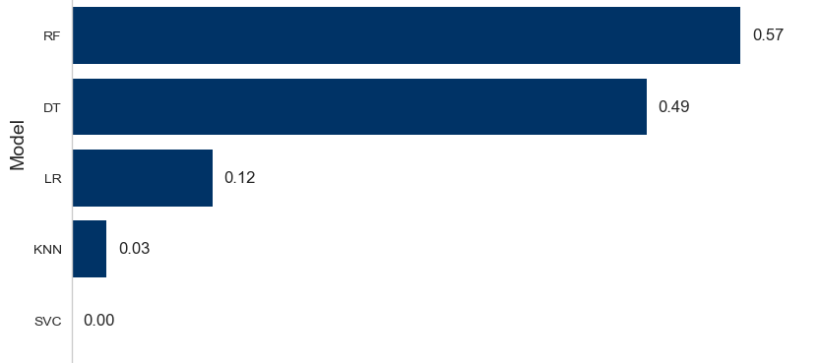
Model F1-Score Result
It is particularly useful as it helps us balance the trade-off between precision and recall, especially in cases where you have an imbalanced dataset.

Slide 17
Model Weaknesses
SVC: It does not handle imbalanced datasets well without proper adjustments.
Logistic Regression: Assumes a linear relationship between features and the target. Hence, it did not capture complex patterns well.
KNN: The computational cost of finding the nearest neighbors increases significantly with the number of features, making KNN less scalable and slower compared to other algorithms.
Random Forest: It might not perform well if not properly tuned. In this case, it was our best performance model
Decision Trees: It can become overly complex by splitting data into many small subsets which allows them to either fit the training data perfectly or underfit. In the case of our case scenario, it underfit.

Slide 18
Conclusion
Random Forest emerged as the best-performing model in predicting bank customer churn due to its ability to handle a diverse set of features effectively and its robustness in capturing complex patterns within the data.
By leveraging multiple decision trees and combining their outputs, Random Forest significantly reduces overfitting and enhances prediction accuracy, making it a powerful tool in identifying at-risk customers.

Slide 19


Online Payment Fraud Detection

Slide 20
Introduction
In our ever-connected digital world, online payments have transformed the way we live, work, and do business. With a simple click, we can transfer funds, make purchases, and access services from anywhere in the world. However, as this convenience grows, so too does the complexity of threats that target our financial security.
But what if we could turn the tide? What if, instead of playing catch-up with fraudsters, we could anticipate their moves and stop fraud in its tracks? This is where machine learning steps in as a game-changer.
By leveraging the most efficient algorithm, we effectively detect and prevent fraud, ensuring a safer online payment experience.

Slide 21
About the Dataset
Data Source: Kaggle
Number of Samples | Number of Features | Number of Target Classes
1,048,575 | 10 | 2 (Fraud, Not Fraud)
Data Features: Time, type(transfer, debit, cash-in, cash-out, payment), amount of the transaction, balance before transt, balance after transt, sender of the transt, recipient of transt, balance of recipient before transt, balance of recipient after transt, is fraud or not
Approach taken to predict Online Fraud
Data Collection and Loading: Gathered and loaded the dataset.
Data Exploration and Cleaning: Explored the dataset and check for missing values.
Data Preprocessing: Encoded categorical variables, scaled features, and split the data.
Model Training: Trained the model using algorithms such as Random Forest, Decision Tree, Logistic Regression, SVC, KNN
Model Evaluation: Evaluated the model using accuracy, precision, recall and f1-score to determine the most optimal model for prediction

Slide 22
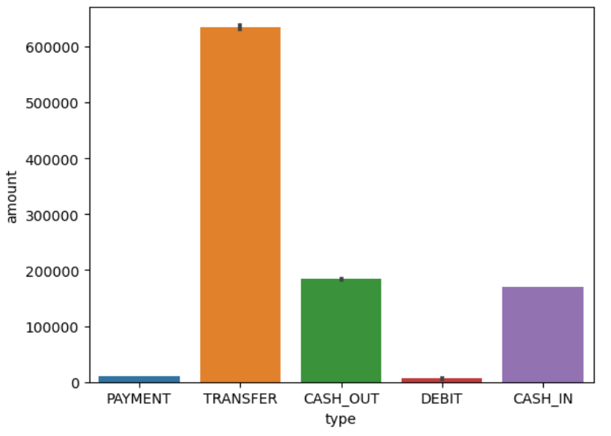
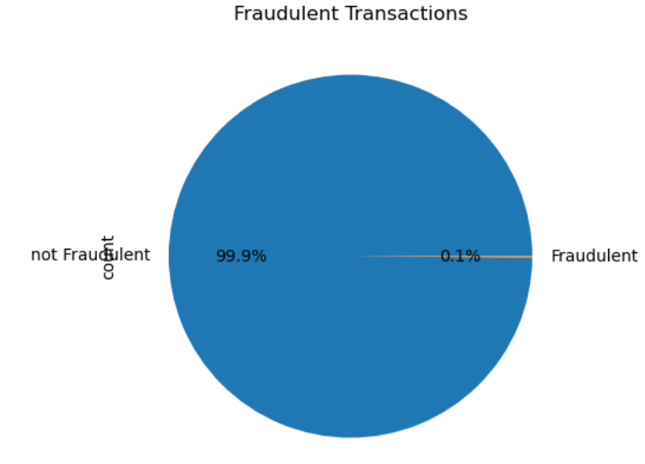
Exploratory Data Analysis
Amount of the transaction
Fraud/Non-Fraud Distribution
Not Fraudulent

Slide 23
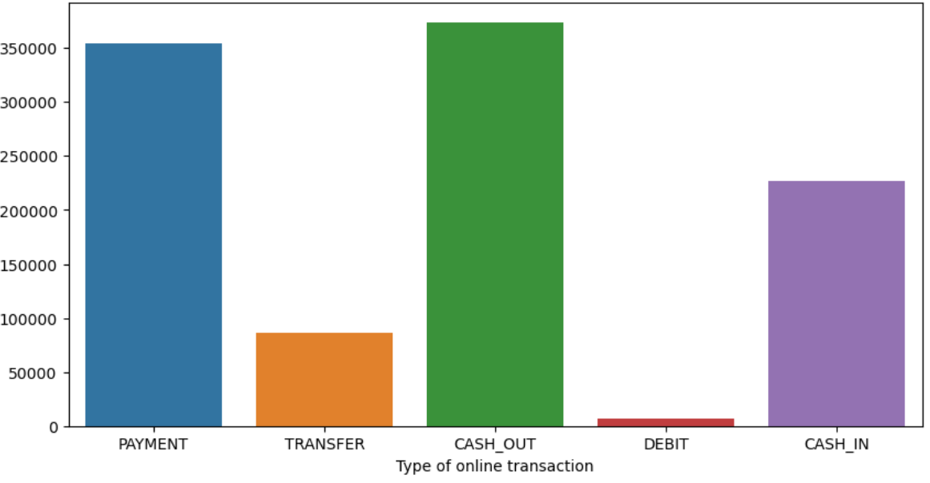
Exploratory Data Analysis
Count of transaction
Fraud/Non-Fraud Distribution
Not Fraudulent

Slide 24
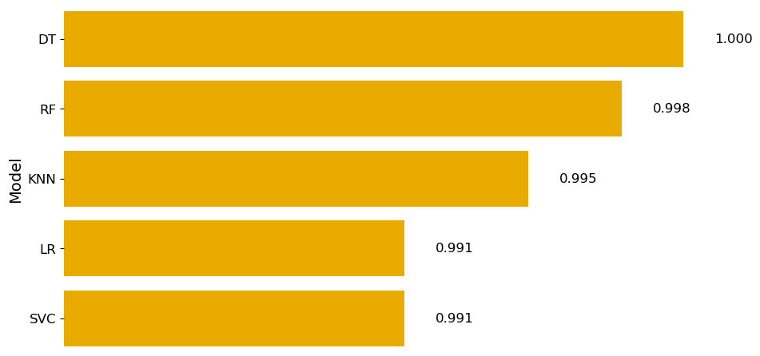
Model Accuracy Result
The goal of using accuracy as a metric is to gauge how well the model is performing overall. It tells us what proportion of the total predictions were correct. A high accuracy score, indicates the model correctly predicts most instances.

Slide 25
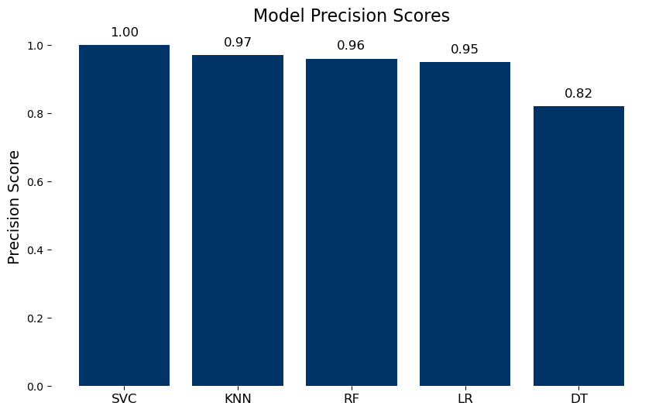
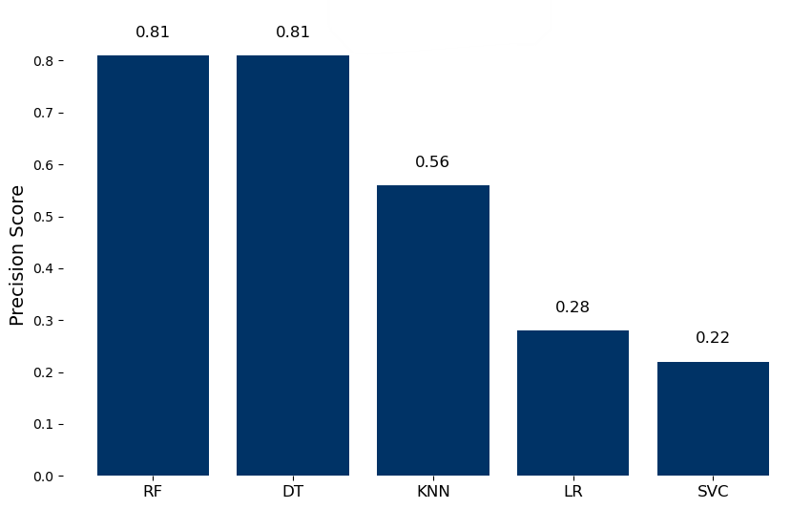
Model Precision, Recall Result
The precision score aim to answer the question, “Out of the online transactions predicted to be fraud by the model, how many were actually fraud?”
The recall score aim to answer the question, “Out of the online transactions that were actually fraud, how many did our model correctly identify?”

Slide 26
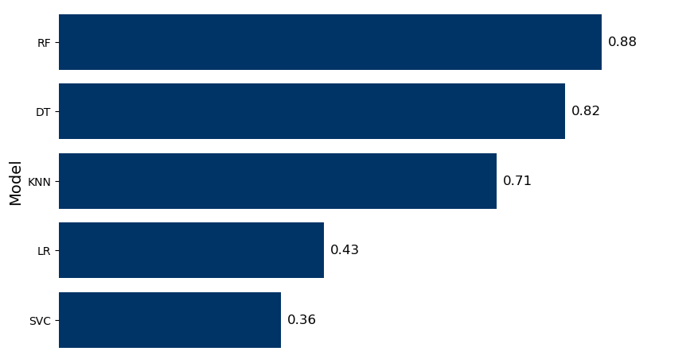
Model F1-Score Result
It is particularly useful as it helps us balance the trade-off between precision and recall, especially in cases where you have an imbalanced dataset.

Slide 27
Model Weaknesses
SVC: challenges with imbalanced data
Logistic Regression: Assumes a linear relationship between features and the target. Hence, it did not capture complex patterns well.
KNN: The computational cost of finding the nearest neighbors increases significantly with the number of features, making KNN less scalable and slower compared to other algorithms.
Random Forest: Can be computationally intensive, but generally performs well on large datasets.
Decision Trees: It can become overly complex by splitting data into many small subsets which allows them to fit the training data perfectly.

Slide 28
Conclusion
Random Forest stands out as the champion in online transaction fraud detection, effortlessly untangling complex patterns and reducing overfitting by harnessing the collective power of multiple decision trees.
While SVM offers high precision, it struggle to correctly classify the minority class. It ended up being biased towards the majority class, leading to fewer correct prediction.
Meanwhile, Logistic Regression and KNN, though simpler, waver when faced with the intricate, high-dimensional challenges of fraud detection.

Slide 29
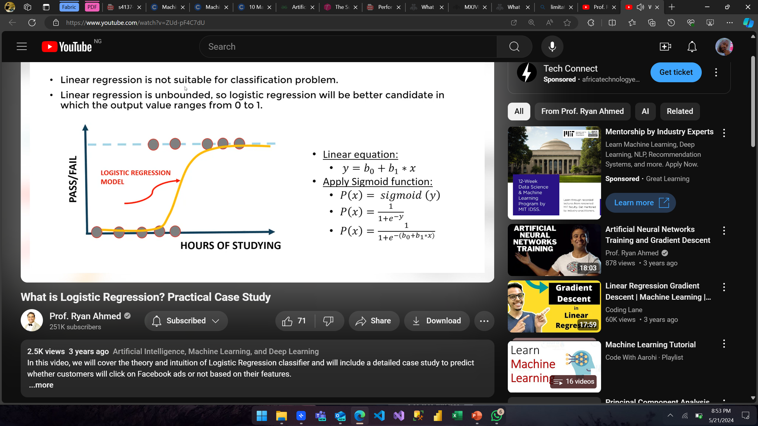
Logistic Regression
A type of algorithm used for binary classification problems. Unlike linear regression, which predicts a continuous outcome, logistic regression predicts the probability of a binary outcome (e.g., yes/no, true/false). The logistic function (sigmoid function) is used to map predicted values to probabilities
Weaknesses of the model
Linearity assumptions
Prone to overfitting
Logistic regression is sensitive to outliers, which can skew the results.
Threshold
Fraud Detection
Loan Approval

Slide 30
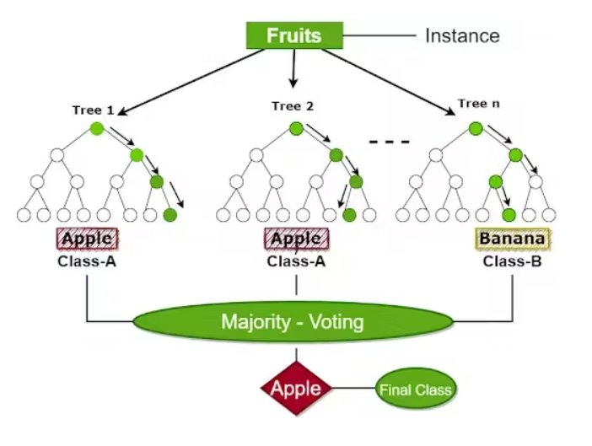
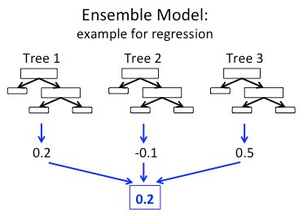
Random Forest
Creates a set of decision trees from randomly selected subset of training set, then combines votes from different decision trees to decide class
Weaknesses of the model
Extrapolation problems.
Harder to interpret (among tree algorithms)
Implementation can be resource-consuming.
Fraud Detection
Loan Approval

Slide 31
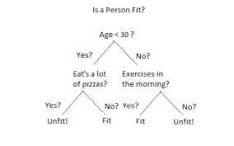
Decision Tree Classifier
Decision trees are a popular algorithm that can be used for classification tasks. A decision tree is a flowchart-like tree structure where an internal node represents a feature(or attribute), the branch represents a decision rule, and each leaf node represents the outcome and do not contain any further branches.
Weakness
For more class labels, the computational complexity of the decision tree may increase.
The decision tree contains lots of layers, which makes it complex.
Decision trees are biased with imbalance dataset, so it is recommended that balance out the dataset before creating the decision tree.
Fraud Detection
Loan Approval

Slide 32
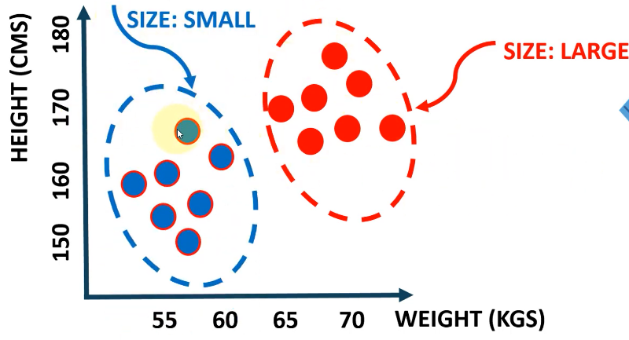
k-Nearest Neighbors
Finds the most similar data points and attempt to make an educated guess based on their classifications. The K-NN algorithm works by finding the K nearest neighbors to a given data point based on a distance metric, such as Euclidean distance. The K in KNN algorithms is the number of neighborhood points to a query point.
Weaknesses of the model
Computationally expensive for large dataset
Very sensitive to noise and outliers
Limited to Euclidian's distance and choice of k- requires extra efforts.
Fraud Detection
Loan Approval

Slide 33
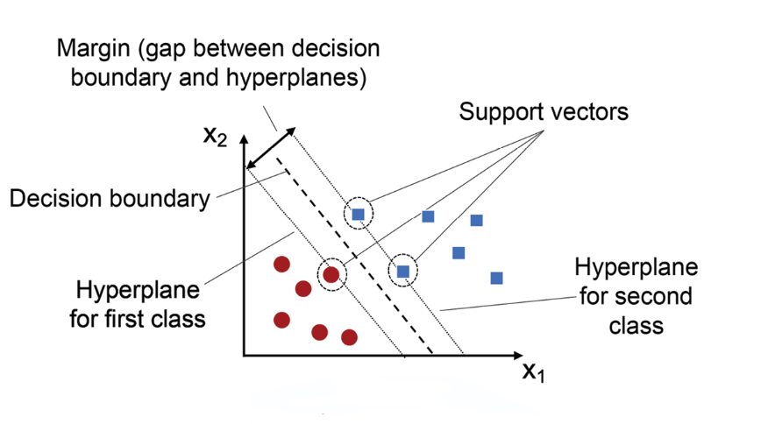
Support Vector Machine(SVM)
Support Vector Machine (SVM) is a algorithm used for both classification and regression.
The main objective of the SVM algorithm is to find the optimal hyperplane in an N-dimensional space that can separate the data points in different classes in the feature space. The hyperplane tries that the margin between the closest points of different classes should be as maximum as possible. The dimension of the hyperplane depends upon the number of features. If the number of input features is two, then the hyperplane is just a line. If the number of input features is three, then the hyperplane becomes a 2-D plane. ​
Weakness of the model
Not suitable for large dataset (memory and time).
Non-probabilistic Classifier (Deterministic from training)
Difficult to implement business logic as the features contribution are not directly seen.
Fraud Detection
Loan Approval

Slide 34
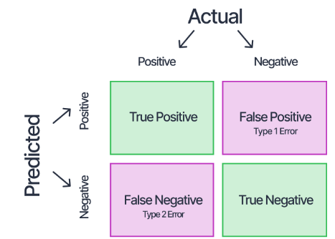
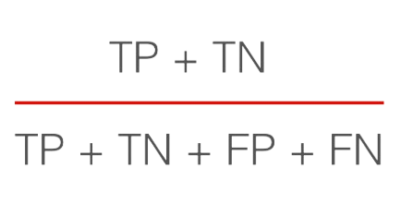
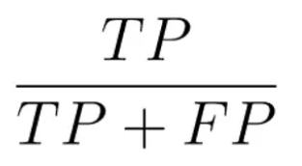
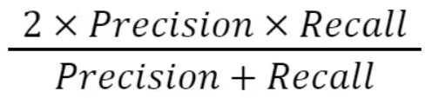
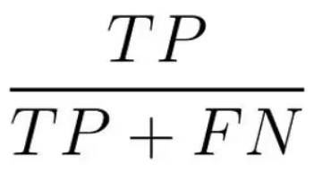
Performances Analysis of the Algorithms
Confusion Matrix
Accuracy: Is the proportion of correctly predicted instances out of all the total instances.
Precision: Measures the proportion of true positive predictions among all positive predictions.
F1-Score: It is the harmonic mean of precision and recall. It ensures the model's balance between precision and recall.
Recall: Measures the proportion of true positive predictions among all actual positive instances.
Fraud Detection
Loan Approval

Slide 35
Financial Service Application of Classification Algorithms
Credit Scoring: Assessing creditworthiness of individuals or businesses based on financial history and payment behavior to inform loan approvals and interest rates.
Risk Assessment: Evaluating and managing various types of risks, including market, credit, and operational risks, to develop risk mitigation strategies.
Customer Churn Prediction: Predicting customer churn to help providers take proactive measures to retain at-risk customers through personalized incentives and improved service.
Fraud Detection: Identifying fraudulent activities such as credit card fraud and identity theft by analyzing transaction data and user behavior patterns.

Slide 36
Regression
Real Case Scenarios

Slide 37
Scenario 4: Customer Lifetime Value Prediction
Customer Lifetime Value (CLTV) represents the total amount of money a customer is expected to spend in a business over a period of time or during his/her lifetime. This is an important metric to monitor because it helps to make decisions about how much money to invest in acquiring new customers and retaining existing ones.
This dataset contains information on transactions for a UK-based and registered non-store online retail.
Shape: 541,909 x 8 Source: UCI Machine Learning Repository Period: 01/12/2010 - 09/12/2011
Features: Invoice no., Product Code, Product Description, Unit Price, Quantity purchased, Customer ID, Invoice Date, and Country
Algorithms
Weaknesses
 | Linear Regression assumes a linear relationship between the predictors and the target variable. However, the relationship in the dataset is not entirely linear, leading to poor performance
 | The performance of Random Forest is highly dependent on parameter tuning (like the number of trees, maximum depth, etc.). If these are not optimally set, it can lead to suboptimal performance
 | Can be computationally expensive especially for large datasets. The large size of the dataset means that training an SVR model can be time-consuming and require substantial computational resources.
Linear Regression
Random Forest Regressor
Support Vector Regressor

Slide 38
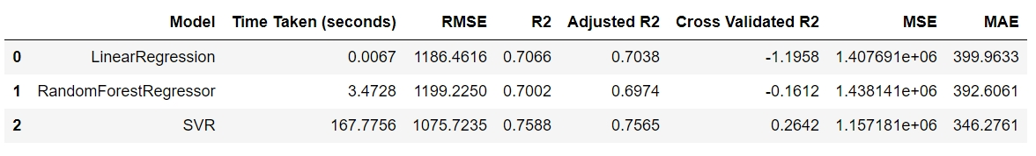
Scenario 4: Performance Analysis
Evaluation Metrics
From the above analysis, we see that
SVR, with its ability to handle non-linear relationships, performs best, with the highest R-squared score indicating that it explains the largest portion of variance in the CLV data
SVR also has the lowest RMSE, and MAE suggesting better predictive accuracy
SVR however takes a longer time to compute compared to Linear Regression which takes the least time to compute
Linear Regression comes right after SVR with the next highest R-square and least RMSE, although it has the highest MAE, indicating that it performs worse in terms of mean absolute error
Random Forest has the lowest R-squared and highest RMSE indicating the least accuracy

Slide 39
Scenario 5: House Price Prediction
The Boston house price prediction dataset includes key features influencing property values, and by analyzing these features, financial analysts can develop predictive models to support strategic decision-making in the finance sector.
Each record in the dataset describes a Boston suburb or town
Shape: 506 x 14 Source: UCI Machine Learning Repository Period: 1970
Features: Crime rate, property tax rates, the average number of rooms, % homeowners considered lower class, the ratio of students to teachers, the median value of owner-occupied homes, weighted distance to Boston employment centers, Charles river dummy variable, nitric oxides concentration, no. of students per teacher in schools, etc.
Algorithms
Weaknesses
 | Prone to being influenced by outliers in house prices or predictor variables which can skew the results and degrade performance
 | Can be computationally intensive, but generally performs well on large datasets.
 | SVR is highly sensitive to the choice of hyperparameters. Without careful tuning, SVR may not fully leverage its potential to model non-linear relationships
Linear Regression
Random Forest Regressor
Support Vector Regressor

Slide 40
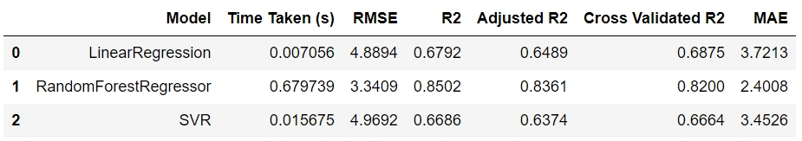
Scenario 5: Performance Analysis
Evaluation Metrics
From the above analysis, we see that
Random Forest Regressor has the lowest RMSE. It also has the lowest MAE. This implies that the distance between the actual and predicted values is minimal compared to the other models. This is a better choice for this dataset as it provides the most accurate and reliable predictions among the three.
Random Forest Regressor also has the highest R-squared value, meaning 85% of the variability in the house prices can be explained by the features in the dataset. This indicates a strong relationship between the features and the target variable.
Linear Regression performs moderately well taking less time than Random Forest but having a better MAE than SVR (possibly due to outliers), and a lower RMSE than SVR
Support Vector Regressor performs the least for this dataset.

Slide 41
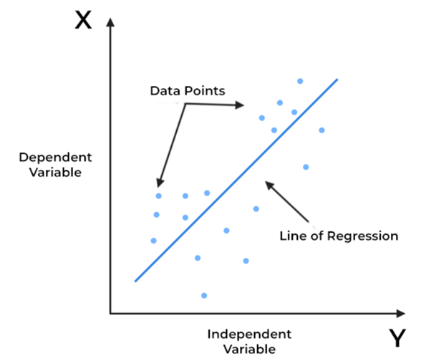
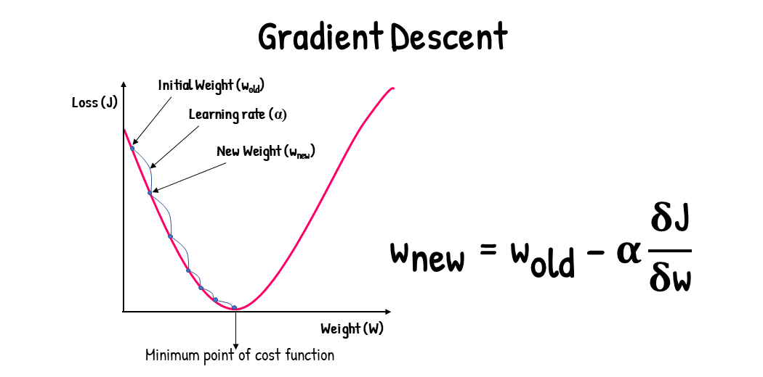
Linear Regression
Linear Regression is an ML algorithm that uses the regression technique. It predicts a continuous value based on input features. We fit a linear model to a set of data points, predict an output y based on input features x, using a linear function (called the hypothesis), and we measure the accuracy of the hypothesis typically using the sum of squared errors (also known as the cost or loss function). We want our predicted value to be as close as possible to the actual value. To get the best fit line, we need to minimize the cost function. One way to minimize this cost function is the Gradient Descent Algorithm.
In gradient descent, we repeatedly take steps to get to the local optimum.
House Price
CLV

Slide 42
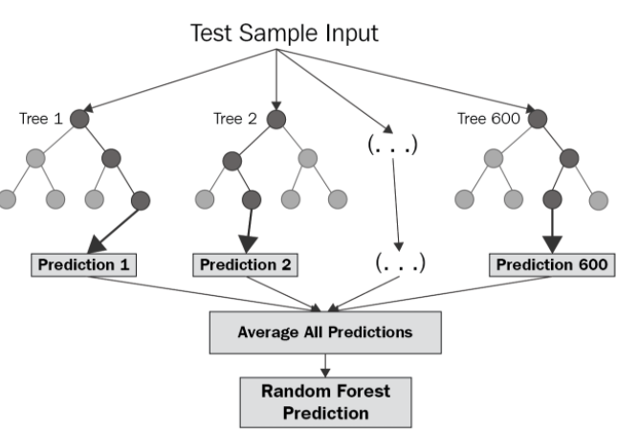
Random Forest Regression
The random forest algorithm is a powerful supervised machine learning technique used for both classification and regression tasks. It is used to find patterns in data (classification) and predicting outcomes (regression). During training, the algorithm constructs numerous decision trees, each built on a unique subset of the training data. These individual trees then vote on the final prediction, leading to a robust and accurate outcome.
House Price
CLV

Slide 43
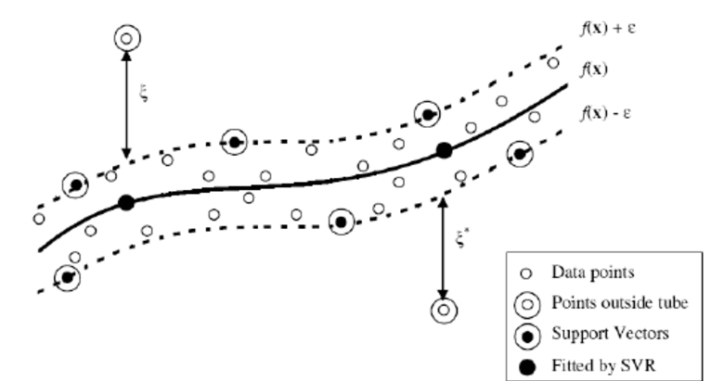
Support Vector Regression
SVMs are typically known for classification tasks, but SVR applies the principles of SVM to predict continuous values rather than discrete classes.
SVR aims to find a function that approximates the relationship between input features and output values as accurately as possible. Instead of minimizing the error between the predicted and actual values directly, SVR aims to fit the best line within a margin of tolerance (epsilon, ε).
Can handle non-linear relationships using different kernels.
Robust to outliers
House Price
CLV

Slide 44
Evaluation Metrics for Regression Models
R-Squared (R²):
Measures the proportion of variance in the dependent variable explained by the model.
Ranges from 0 to 1, higher generally indicates a better fit.
Adjusted R-Squared (Adj. R²):
used to determine how reliable the correlation is and how much it is determined by the addition of independent variables.
It is always lesser or equal to the R2.
Mean Squared Error (MSE):
Average of the squared differences between predicted and actual values.
Sensitive to outliers, as squaring emphasizes large errors.
Root Mean Squared Error (RMSE):
Square root of MSE
More interpretable as it's in the same units as the target variable.
Mean Absolute Error (MAE):
Average of the absolute differences between predicted and actual values.
Less sensitive to outliers than MSE or RMSE.
Cross Validated R-Squared (CV-R²):
Used to evaluate performance particularly when dealing with a limited amount of data.
The average R-squared score across k folds
House Price
CLV

Slide 45
Financial Applications of Regression Algorithms
Sales Forecasting: Predicting future sales of banking products with factors like economic conditions, customer behaviour, and past sales data. Useful for branch performance analysis.
Macroeconomic Impact Assessment: Analyzing the impact of macroeconomic variables (e.g. inflation, GDP growth) on operations and financial performance, to help strategic planning.
Customer Lifetime Value: Linear regression can help estimate the future value a customer will bring to the bank by analyzing past behavior, enabling better customer relationship management and retention strategies.
Marketing Campaign Effectiveness: Analyzing customer data to identify patterns and trends, to predict which customers are likely to respond to specific marketing campaigns, thereby enabling more targeted and effective outreach

Slide 46
Clustering

Slide 47
Clustering
It involves dividing data sets into groups based on their attributes or features. In simple words, clustering aims to segregate groups with similar traits and assign them into a cluster. It has many applications spread across various domains such as finance, the medical field, recommendation engine, etc. In a banking context, this precise grouping allows for more targeted strategies in marketing, product recommendations, customer segmentation, risk management, etc.
Clustering is broadly divided into two subgroups:
Hard Clustering: Each input data point either fully belongs to a cluster or not.
Soft Clustering: Rather than assigning each input data point to a distinct cluster, it assigns a probability or likelihood of the data point being in those clusters.

Slide 48
Scenario 7 – Credit Risk Profiling
Credit Risk Assessment: Grouping borrowers based on their credit risk profile will help determine the terms of loan and credit limits to make well-informed credit decisions and help optimize loan processes, thereby enhancing operational efficiency.
The dataset contains about 10000 entries with various features related to customer credit profiles such as Credit Score, Annual Income, Monthly debt, Current loan amount, Current credit balance, etc.
Algorithm Performance
MODEL | Davies Bouldin Index | Silhouette Score
K Means | 1.921984 | 0.250483
GMM | 1.562570 | 0.453328
DBSCAN | 1.472934 | 0.572268
K-Means is less effective for this dataset, indicating it is unsuitable if clusters are not spherical or there are significant outliers/noise. GMM Performs better than K-Means and is useful when clusters are not strictly spherical. DBSCAN is best for this dataset due to its higher silhouette score and ability to handle noise and find non-globular clusters.

Slide 49
Conclusion
The clustering analysis provides a separation of customer credit risk levels. By leveraging these clustering techniques, the bank can enhance their risk management practices, leading to more precise customer profiling and targeted strategies for mitigating potential credit risks and optimize loan process.

Slide 50
Scenario 8 – Marketing Strategy For Credit Cards
Segmenting credit card customers into several groups according to customer behavior to get an effective and efficient credit card marketing strategy. Here, instead of creating different strategies for individual customers, the bank can make different strategies or offers, one for each group. This will reduce the effort as well as the time.
The dataset used contains the usage behavior of over 8000 credit card users for six months with features like balance, credit limit, purchases, minimum payment, tenure etc.
Algorithm Performance
MODEL | Davies Bouldin Index | Silhouette Score
K Means | 0.801000 | 0.608000
GMM | 0.863000 | 0.388000
DBSCAN | 1.287000 | 0.803000
The table above shows that the K-Means algorithm has the lowest Davies-Bouldin index compared to the other two algorithms, which implies K-Means has the decent clustering quality compared to the other two algorithms. By silhouette score, K-Means has the second highest silhouette score. It can be concluded that K-Means has the best clustering quality of the three algorithms due to the lowest Davies-Bouldin index value.

Slide 51
Conclusion
This will help the bank in tailoring their products, services to meet the specific needs and preferences of different customer groups as regarding Credit Cards, thereby enhancing their service delivery, profitability and operational efficiency.

Slide 52
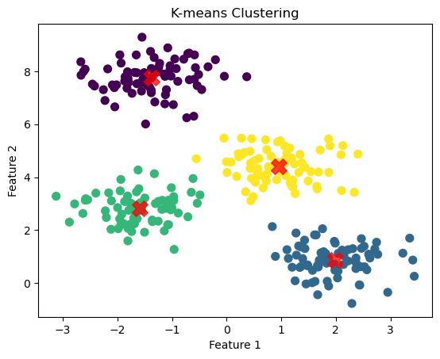
K Means Clustering
K means Clustering is a centroid-based algorithm, it groups the closest data points to form a cluster, and each cluster is associated with a centroid. Based on the number of clusters, k centroids is initialized. The data points are then assigned to the closest centroid and a cluster is formed. The centroids are then updated, and the data points are reassigned, the process goes on iteratively until convergence.
Weaknesses of k-means Clustering
The number of clusters (K) needs to be specified in advance
The clusters created are mostly spherical, this is because k means assumes that clusters are spherical.
Convergence to local optimum.
Associated Use Risks
Choosing an incorrect K can result in poor clustering performance and misleading insights.
It can lead to incorrect clustering if the data contains elongated or irregularly shaped clusters.
Credit Risk
Market Strategy

Slide 53
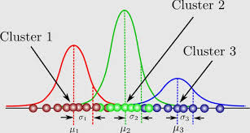
Gaussian Mixture Model
Gaussian Mixture Models (GMM) are another type of clustering algorithm that addresses some limitations of K-means, particularly regarding the shape and size of clusters. It models the data as a mixture of several Gaussian distributions or components, each representing a cluster. The parameters of the mixture components, such as the means and covariances, are typically estimated using the Expectation-Maximization (EM) algorithm.
Advantages Of GMM
Flexibility in Cluster Shape
Handles Missing Data
Handles Complex Data Distributions
Credit Risk
Market Strategy

Slide 54
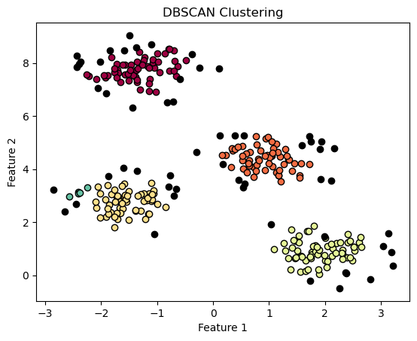
DBSCAN
DBSCAN (Density-Based Spatial Clustering of Applications with Noise) is robust to noise or outliers and can identify clusters of varying shapes and sizes. It is well-suited for datasets where the underlying cluster structure is not well-defined or has irregular characteristics.
KEY PARAMETERS
Eps(epsilon)
Min_samples
DBSCAN Algorithm Steps
Parameter Initialization
Visit Each Point
Cluster Formation
Identify Noise

Slide 55
Weaknesses of DBSCAN
Parameter Sensitivity: The performance of DBSCAN heavily depends on the choice of the parameters.
Computational Complexity: DBSCAN has a higher computational cost, especially for large datasets.
Advantages of DBSCAN
Detects Arbitrarily Shaped Clusters
Robust to Noise and Outliers
No Need to Specify Number of Clusters
Performance Evaluation Of Clustering
The silhouette score measures how similar an object is to its own cluster compared to other clusters, measures cluster separation.
Davies Bouldin Index is a validation metric that is used to evaluate clustering algorithm, it considers both compactness and separation (compactness refers to how tightly data points within a cluster are grouped together)
Credit Risk
Market Strategy

Slide 56
Reinforcement Learning

Slide 57
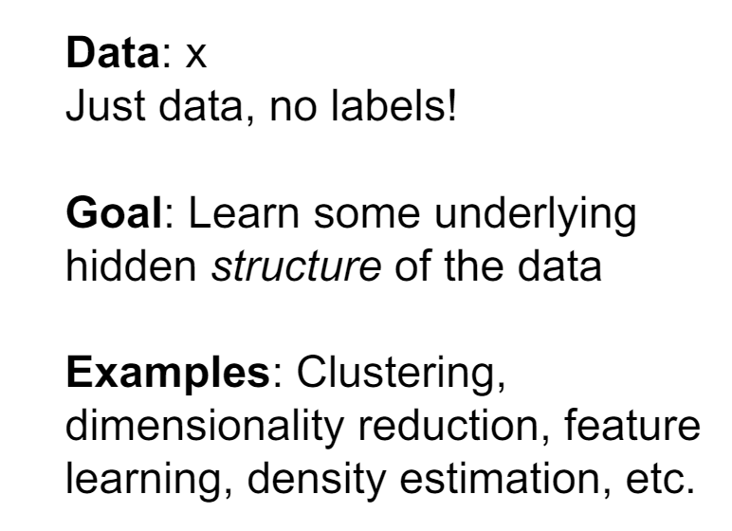
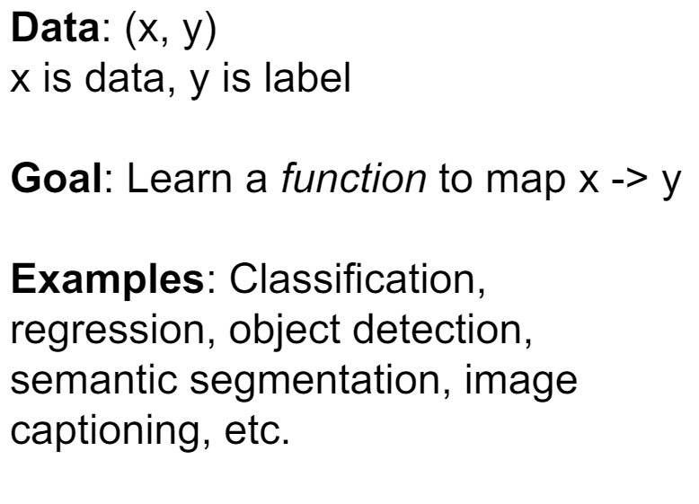
So far …
Supervised
Unsupervised

Slide 58
What is Reinforcement Learning?
RL is the type of learning where an agent learn from experiences of interacting with an environment, observing and responding to results. It aims to solve problems that involve making Sequential Optimal Decisions under Uncertainty.
These problems can be described Markov-Decision Process, representing the state, action(s), and reward systems.
This distinctive learning paradigm empowers machines/agents to autonomously discover optimal strategies for tasks ranging from game playing to robotic control, financial decision-making, among others.
It is sometimes said that SML and UML are about “minimization” (i.e., they minimize the fitting error of a model to the presented data), while RL is about “maximization” (i.e., RL identifies the suitable decisions to be made to maximize a well-defined objective).

Slide 59
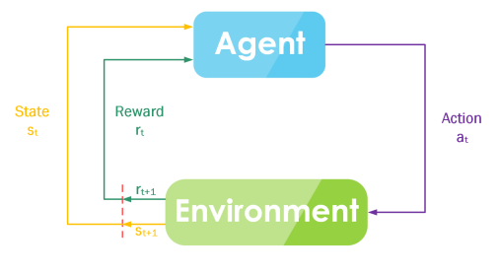
RL Formalization
Policy: dictates the agent's behavior. It's a mapping from states to actions.
Value Function: estimates how good a state (or taking a specific action in a state) is for the agent in terms of future rewards.
Q-value Function: estimate the expected long-term profit for each possible action in the current state, considering the policy's future actions.

Slide 60
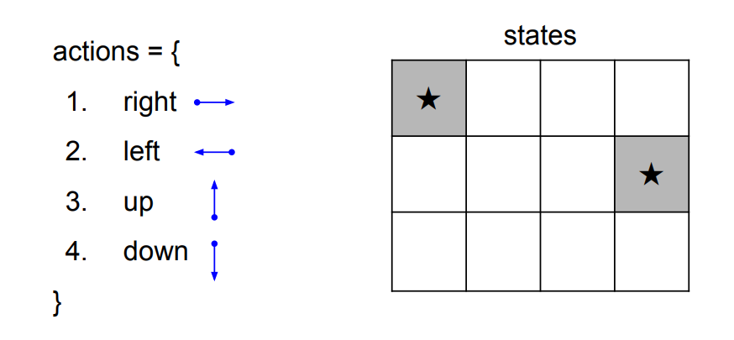
A Simple MDP: Grid World
Goal: reach one of terminal states (greyed out) in
least number of actions

Slide 61
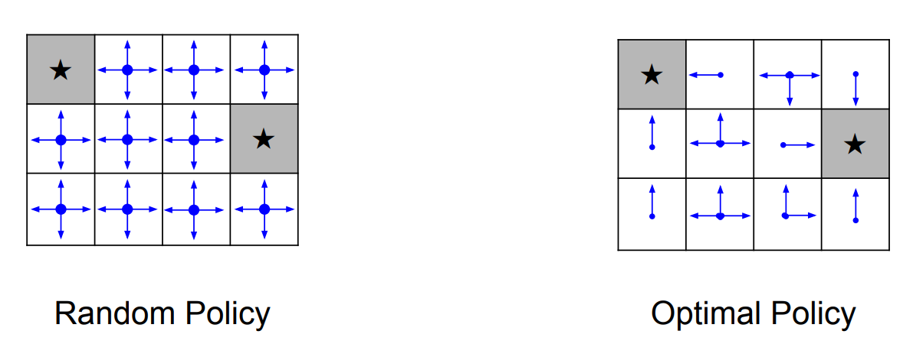
A Simple MDP: Grid World
Goal: reach one of terminal states (greyed out) in
least number of actions

Slide 62
RL Algorithms
Model-based
Model-free
SARSA
Markov Decision Process P(s’, s, a)
Policy Iteration
Value Iteration
Q-Learning Q(s, a)
Policy Gradient Optimization
Dynamic programming and Bellman Optimality
Deep Reinforcement Learning

Slide 63
Challenges in RL
Credit Assignment Problem (Sampling Efficient and Sparse Rewarding)
Computationally Expensive
Challenging Performance Measurements / Evaluation
Higher technical skills required for implementation

Slide 64
Values from AI technologies
Generative AI
Reinforcement Learning
Supervised ML
Unsupervised ML
Source: Stanford University

Slide 65
Application of RL in Finance
Algorithmic Trading
Bots powered with reinforcement learning can learn from the trading and stock market environment by interacting with it. They use trial and error to optimize their learning strategy based on the characteristics of each stock listed in the stock market.
This helps to save time, achieve 24hrs trading time, and trading gets diversified across all industries to maximize profits.

Slide 66
Application of RL in Finance
Product Recommender System
Traditional systems relies on techniques like collaborative filtering (users with similar behavior get similar recommendations) or content-based filtering (products similar to what the user liked are recommended) and there are limited ability to adapt to changing user preferences or market conditions.
RL-powered systems can continuously learn from user interactions and feedback on recommendations and can optimize recommendations in real-time based on factors like user goals, risk tolerance, and market fluctuations.

Slide 67
Thank you

